Slide 1
Team-22
Simulating Drip Irrigation (DI) System For Optimizing Water Use Efficiency
Labiba Tasfiya Jeba ; ID: 22266028
Abrar Al Sayem ; ID: 18201194
Tasfia Anika Bushra ; ID: 23166013
ST: Farah Binta Haque
RA: Md Sabbir Hossain

Slide 2
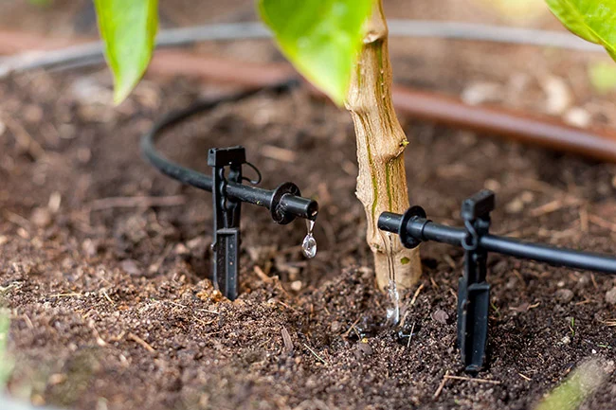
TOC
TOC
Introduction
Why use drip irrigation system
Background
Project Idea
Features
System Architecture
Observations
Potential challenges
Conclusion

Slide 3
Introduction
A method of applying water to plants at a low flow rate, directly to the root zone.
Consists of a network of pipes that delivers water to emitters, which are small devices that release water at a slow rate.
Drip irrigation system simulation is a computer program that models the performance of a drip irrigation system under varying conditions.
Used to understand the irrigation requirements, system efficiency, and water usage over a specified period.

Slide 4
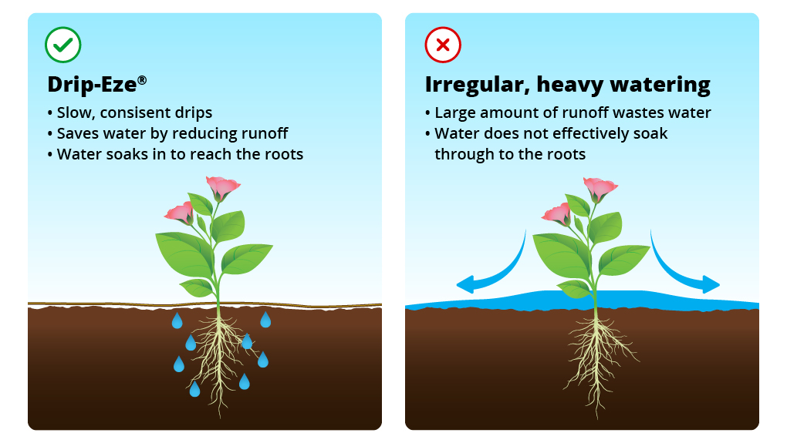
Why use drip irrigation system
The irrigation requirements for a specific crop and location
The size and type of emitters required for a specific system
The flow rate and pressure required to deliver the desired amount of water
The water usage and efficiency of the system

Slide 5
Background
“Edge computing: A tractable model for smart agriculture? “: Discusses potential of edge computing as a model for smart agriculture. The authors argue that edge computing can help to overcome the challenges of internet connectivity in rural areas and provide real-time data processing and analysis for farmers.
“Agriculture monitoring system: A study”: The proposed agriculture monitoring system (AMS) consists of three main components: data acquisition unit, Android-based smartphone application, and web server. The AMS can provide real-time monitoring of soil moisture and temperature conditions, allowing farmers to make informed decisions about irrigation, fertilization, and pest control.

Slide 6
Background
3. “Application of AI techniques and robotics in agriculture: A review”: The paper reviews the application of artificial intelligence (AI) and robotics in agriculture, highlighting their potential to enhance crop production, optimize resource utilization, and improve agricultural practices. It emphasizes the use of AI techniques for precision agriculture, while discussing the challenges and future directions in the field.
4. “Simulated IoT Based Sustainable Power System for Smart Agriculture Environments”: The paper proposes a simulated IoT-based sustainable power system for smart agriculture environments, utilizing renewable energy sources and load scheduling techniques to ensure continuous operation of agricultural systems. The proposed system effectively manages power consumption and optimizes energy usage, promoting sustainability in agricultural practices.

Slide 7
Project Idea
This project aims to develop a simulation model that optimizes water use in drip irrigation (DI) systems by integrating soil moisture data, weather forecasts, and crop water requirements. The model will provide farmers and agricultural professionals with a valuable tool for making informed irrigation decisions, conserving water, and enhancing crop yields.

Slide 8
Weather and Soil Moisture Simulation
System Flow Rate
Irrigation Requirement
Features
Pressure Loss
Application Rate

Slide 9
System Architecture
Calculations
Simulating Drip Irrigation
- System flow rate
- Pressure loss
- Application Rate
- Irrigation time
Inputs
Inputs
-
-
-
-
Calculations
- initial soil moisture
- irrigation system efficiency
- Flow Rate
- length
- Diameter
- Hazen-Williams coefficient
- crop water need
- area
- emitter spacing
- row spacing
- days
- System flow rate
- Pressure loss
- Application Rate
- Irrigation time
Weather and Soil Condition
Weather and Soil Condition
- [Day], [Rainfall], [ET]
- Soil Moisture
- [Day], [Rainfall], [ET]
- Soil Moisture
Simulate

Slide 10
Soil Moisture
Water Usage Over Time
Rainfall vs. Irrigation
Observations
Water Usage for Irrigation
Evapotranspiration (ET) Rates

Slide 11
Potential challenges
Data Acquisition and Modeling
Accurate Weather and Soil Data
Soil Characterization
Crop Water Requirement Estimation
Simulation Validation and Refinement
Model Validation with Field Data
Model Refinement and Sensitivity Analysis
User-Friendly Interface and Decision Support Tools

Slide 12
Conclusion
Drip irrigation system simulation has emerged as a powerful tool for optimizing water use efficiency in agriculture.
Informed decisions made with the aid of simulation models can conserve water and enhance crop yields.
Addressing challenges related to data acquisition, system design, and model validation is crucial for effective simulation.
Integrating advanced features, such as real-time monitoring and adaptive irrigation scheduling, can further improve efficiency and sustainability.
Drip irrigation system simulation is an invaluable tool for promoting sustainable agricultural practices and ensuring food security.

Slide 13
Reference
M. J. O'Grady, D. Langton, and G. M. P. O'Hare, "Edge computing: A tractable model for smart agriculture?," Artificial Intelligence in Agriculture, vol. 3, pp. 42-51, 2019.
"Agriculture Monitoring System: A Study," 2023. [Online]. Available: https://www.researchgate.net/publication/283331223_Agriculture_monitoring_system_A_study
M. Wakchaure, B. K. Patle, and A. K. Mahindrakar, "Application of AI Techniques and Robotics in Agriculture: A Review," Artificial Intelligence in the Life Sciences, vol. 3, no. 1, pp. 100057, 2023.
. S. Abou Emira, K. Y. Youssef, and M. Abouelatta-Ebrahim, "Simulated IoT Based Sustainable Power System for Smart Agriculture Environments," in Proceedings of the 2021 International Conference on Artificial Intelligence, Image Processing, and Eco-Friendly Energy (AIIEEE) 2021, pp. 1-5.

